Slide 1
Casual riders vs cyclistic members bike usage
Presented by: Jurineil L. Llaneta
Date: MM/DD/YYYY

Slide 2
agenda
Differentiate usage of Cyclistic bikes between Casual Riders and Cyclistic Members

Slide 3
agenda
Differentiate usage of Cyclistic bikes between Casual Riders and Cyclistic Members
Determine how Casual Riders would buy Cyclistic Annual Membership

Slide 4
agenda
Differentiate usage of Cyclistic bikes between Casual Riders and Cyclistic Members
Determine how Casual Riders would buy Cyclistic Annual Membership
Actionable Steps to convert Casual Riders into Cyclistic Member

Slide 5
Objectives
Convert Casual Riders into Cyclistic Member
Use digital media to influence casual riders to become members

Slide 6
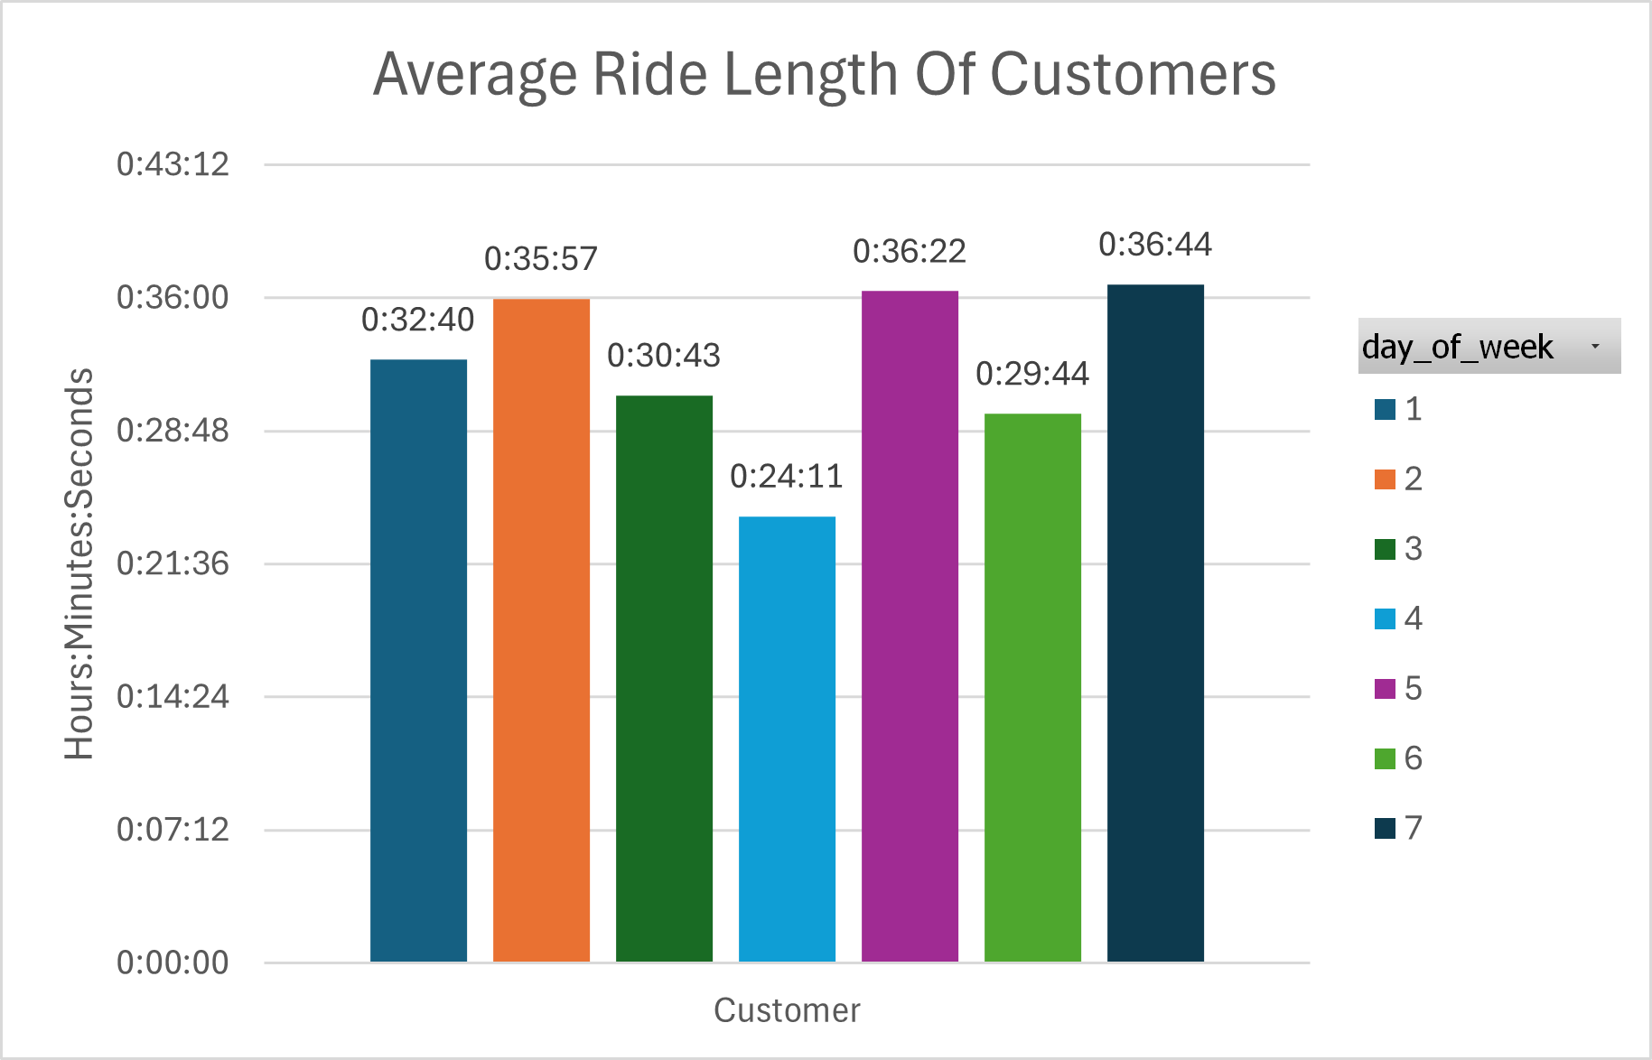
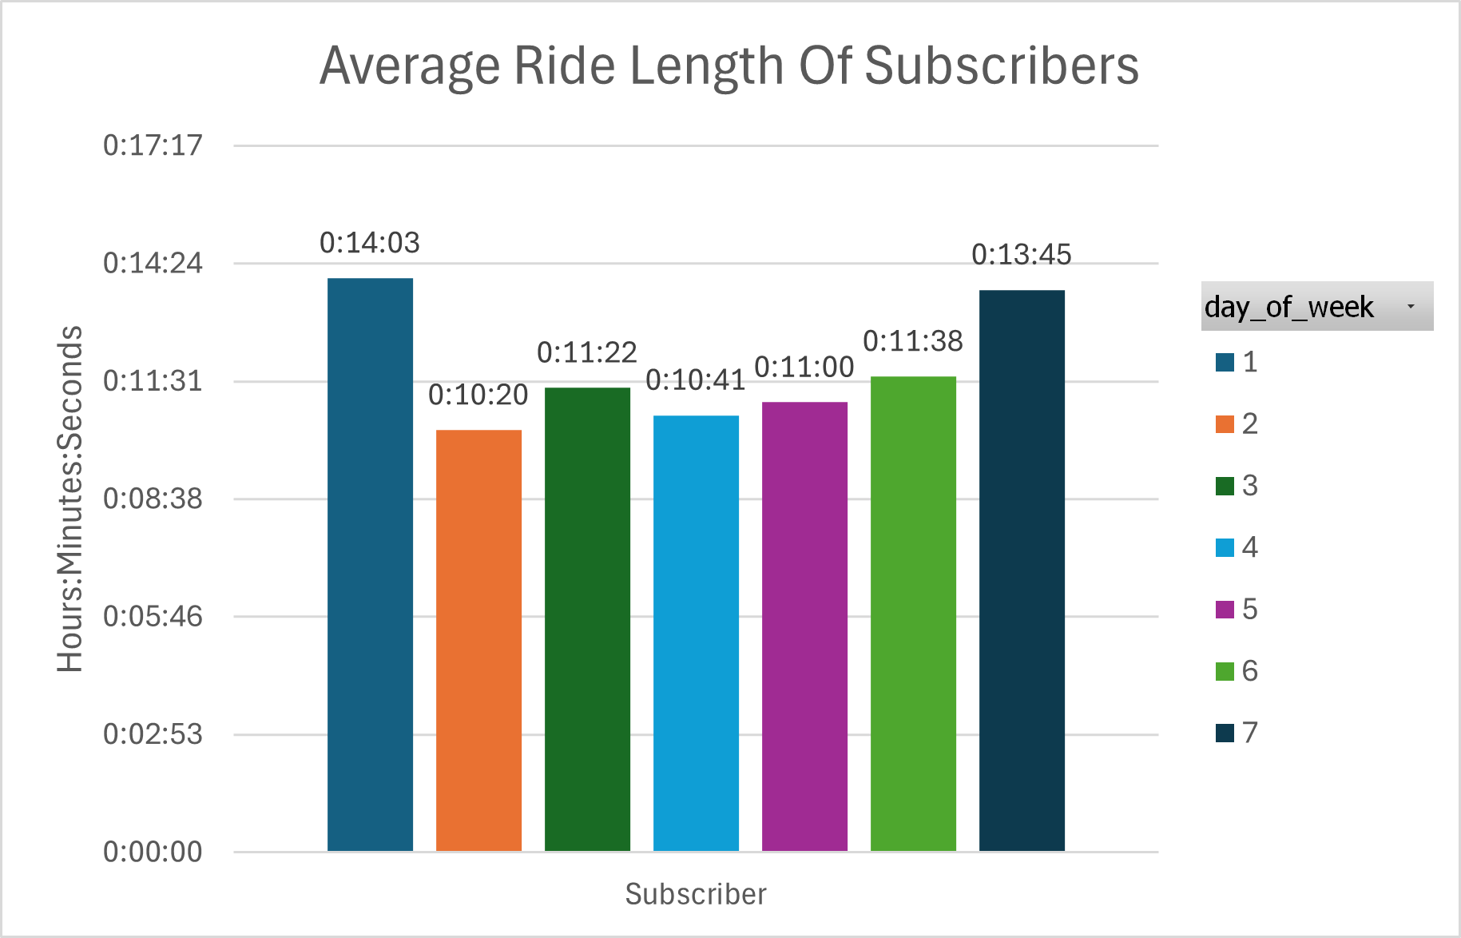
Casual riders vs cyclistic members average ride length
Casual Riders have higher average ride length than Cyclistic Members

Slide 7
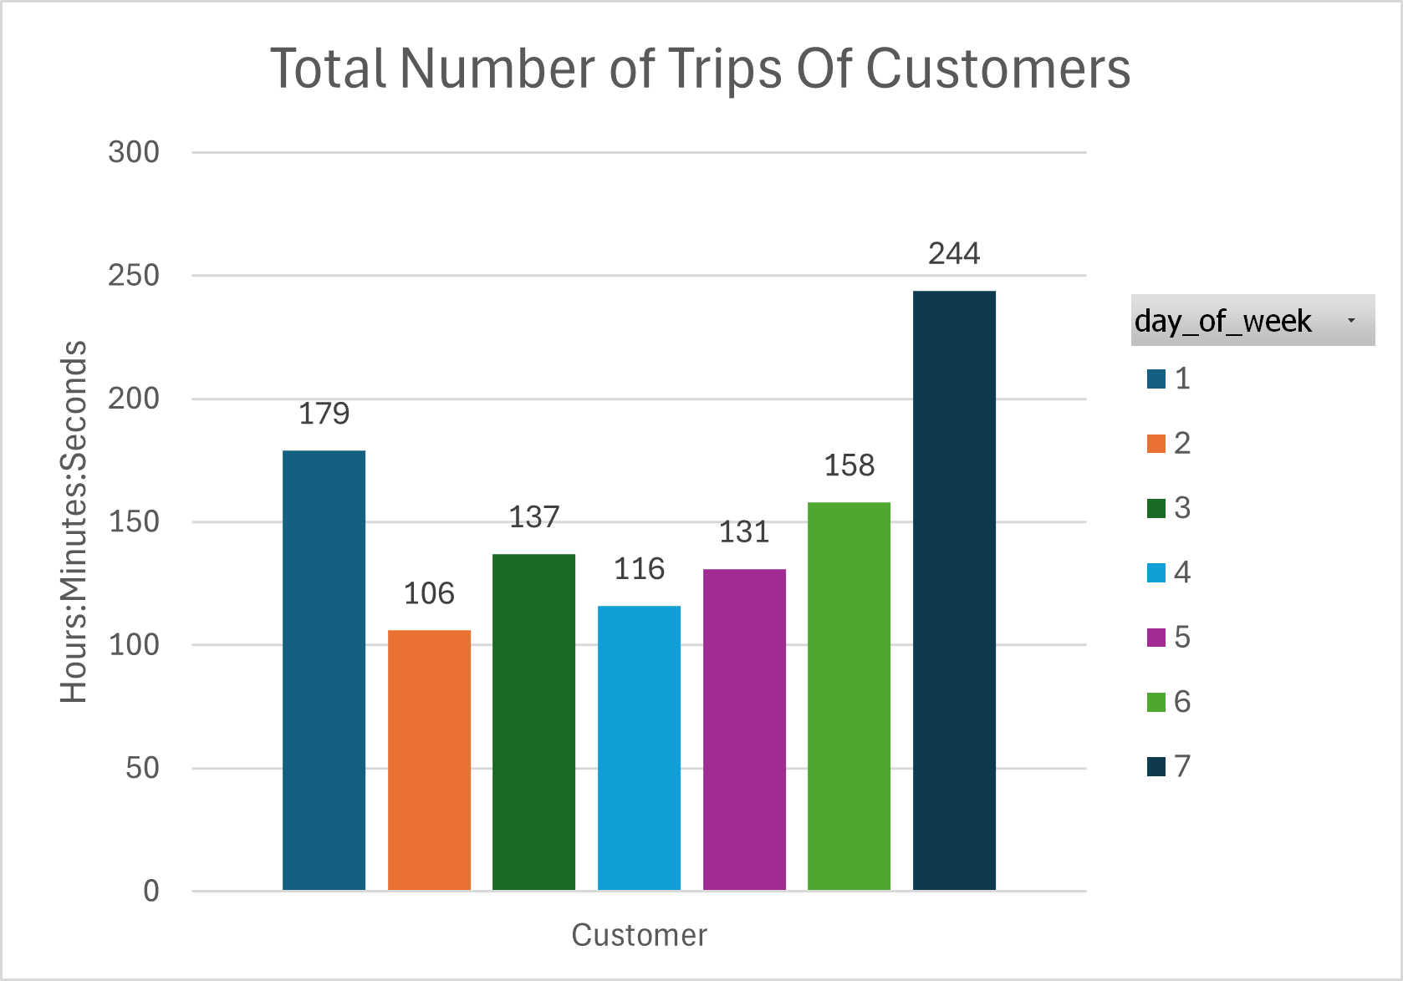
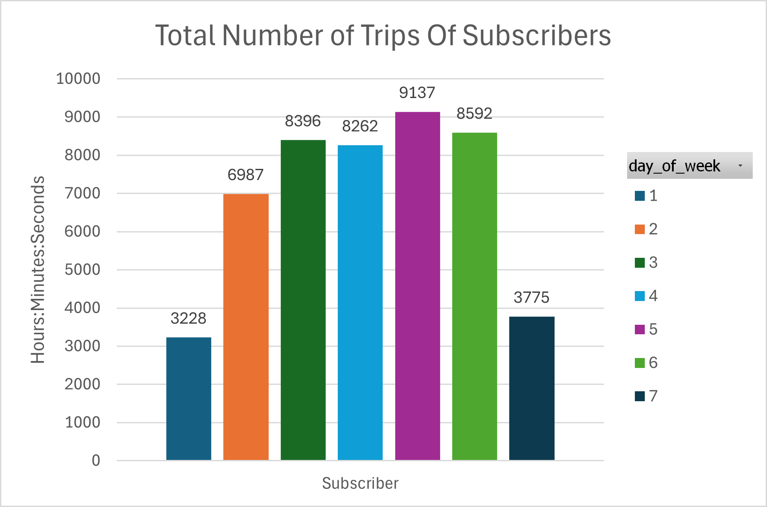
Casual riders vs cyclistic members total number of trips
Casual Riders have higher number of trips during weekends
Cyclistic Members have higher number of trips during weekdays

Slide 8
Conclusions
Casual Riders favor occasional, longer, and leisure-focused trips, especially on weekends.
Cyclistic Members exhibit regular, shorter, and weekday-focused trips, reflecting their reliance on the service for routine purposes.

Slide 9
Recommendations
Limit Ride Length for Casual Customers
Offer Additional Ride Length to Members/Subscribers
Make a subscription tier option
-like for students
-senior citizens
- or just a regular

Slide 10
Actionable steps
Set a ride length limit that balances revenue and customer satisfaction
Identify a value threshold where offering additional ride length incentivizes memberships while maintaining profitability.
Leverage digital channels like social media, email, and app notifications to reach casual riders with personalized offers, testimonials, and success stories from other riders who transitioned to membership.

Slide 11
Actionable steps
For students
Require proof of enrollment (e.g., student IDs) for eligibility.
Offer free trial periods or introductory discounts to encourage sign-ups.
For senior citizen
Create a simple verification process for senior eligibility.
Develop user-friendly app interfaces or support systems for seniors.
For regular
Offer a flexible pricing structure with monthly, quarterly, and annual payment options.
Highlight the cost savings compared to casual rides in promotional materials.

Slide 12
Thank you!!!

